Slide 1
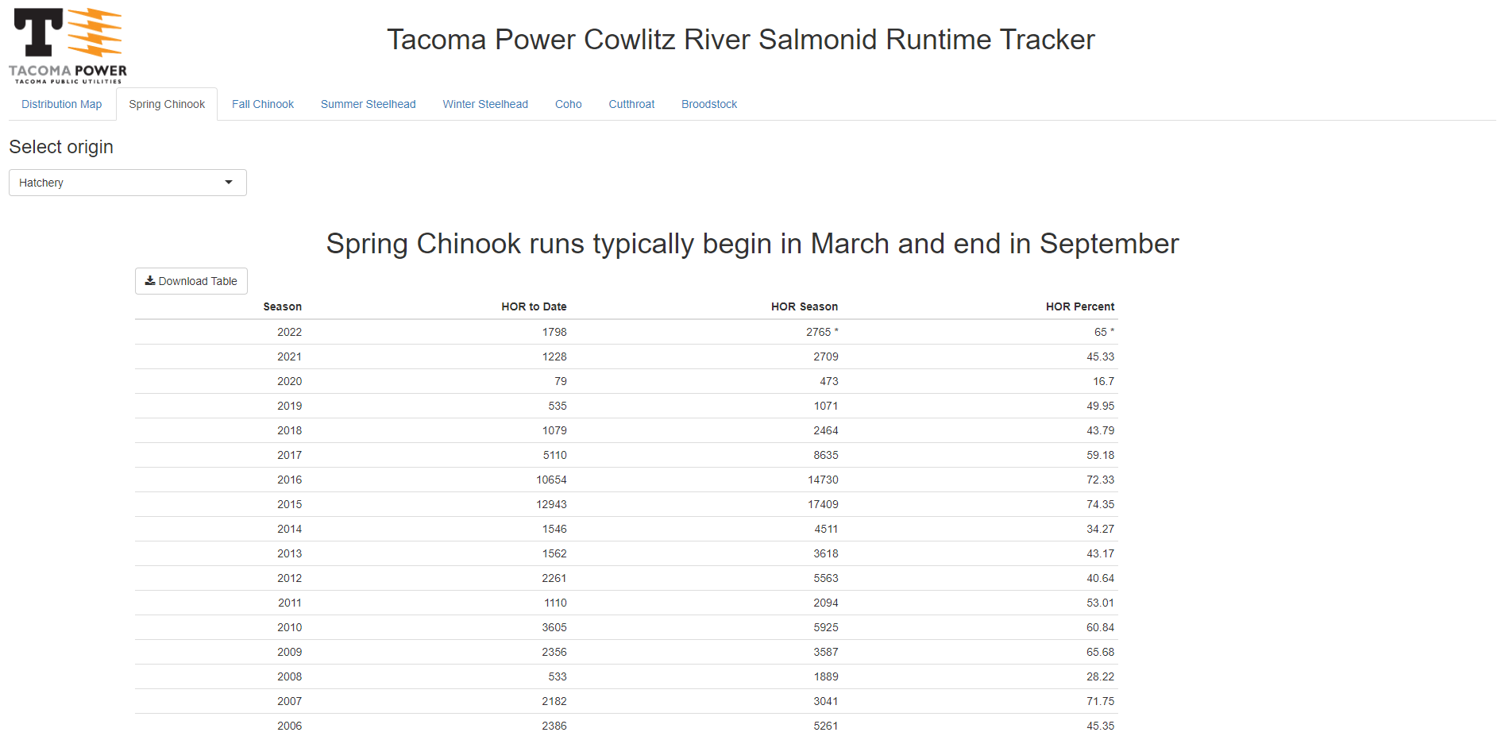
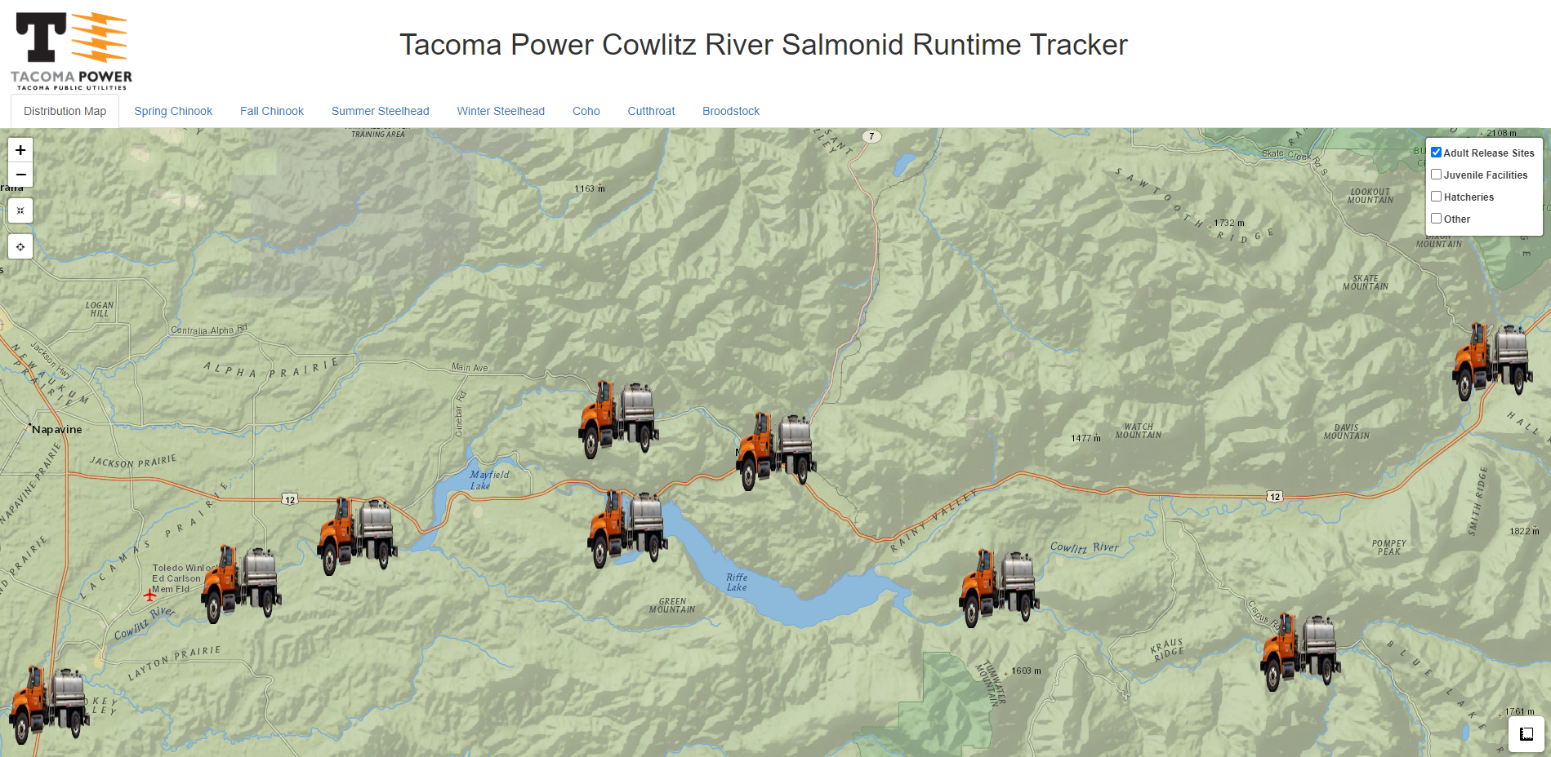
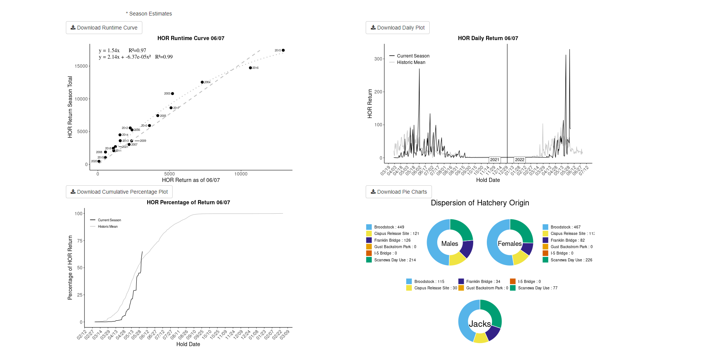
Cowlitz River Salmonid Runtime Tracker
In-depth Rshiny application
Advanced Statistical Analysis and Modeling
Time Series Visualizations
Live data pipeline constructed using Access, FME, Databricks, AWS, Snowflake and Shiny
https://tacoma.shinyapps.io/cowlitz_runtime_app/

Slide 2
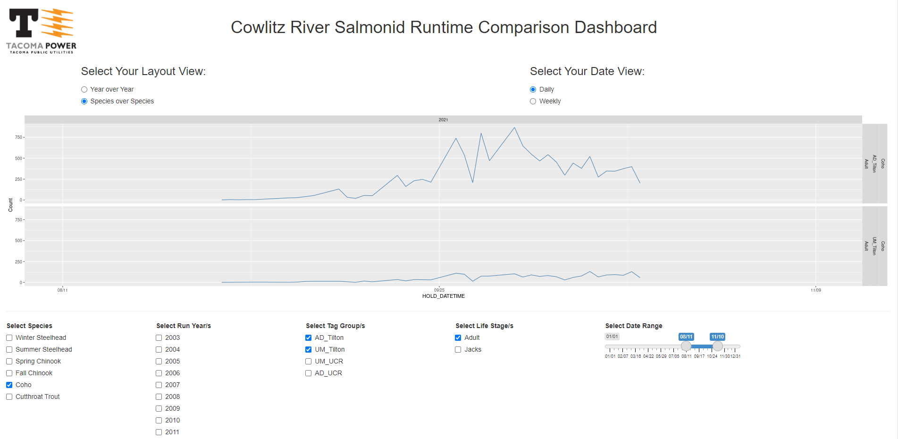
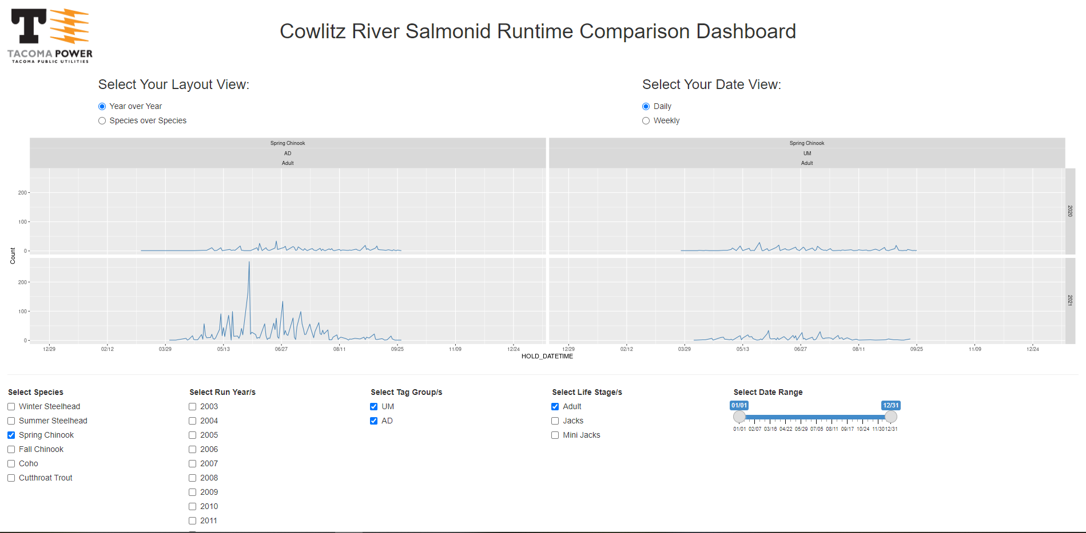
Cowlitz River Salmonid Runtime Tracker Comparison Dashboard
Rshiny reactive dashboard
Time Series Visualizations
Advanced display of reactive ggplots
Live data pipeline constructed using Access, FME, Databricks, AWS, Snowflake and Shiny
https://tacoma.shinyapps.io/testing_reactive_graphs/

Slide 3
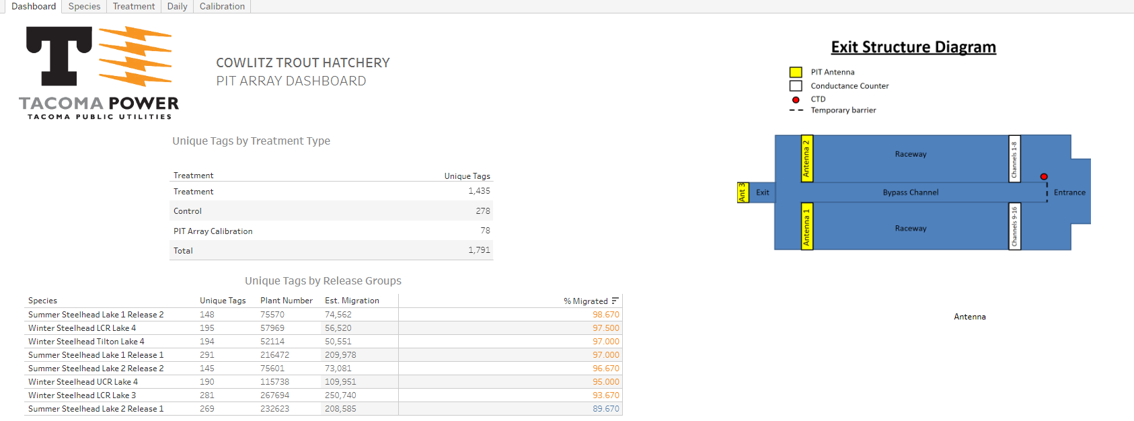
Cowlitz Trout Hatchery PIT Array Dashboard - Tableau
Tableau Dashboard
Daily data pipeline constructed using Excel, FME, AWS, Snowflake and Tableau
Designed as a tool for monitoring by City of Tacoma Employees
https://analytics.tacoma.lcl/#/views/COWLITZ_TROUT_PIT_ARRAY/Dashboard1

Slide 4
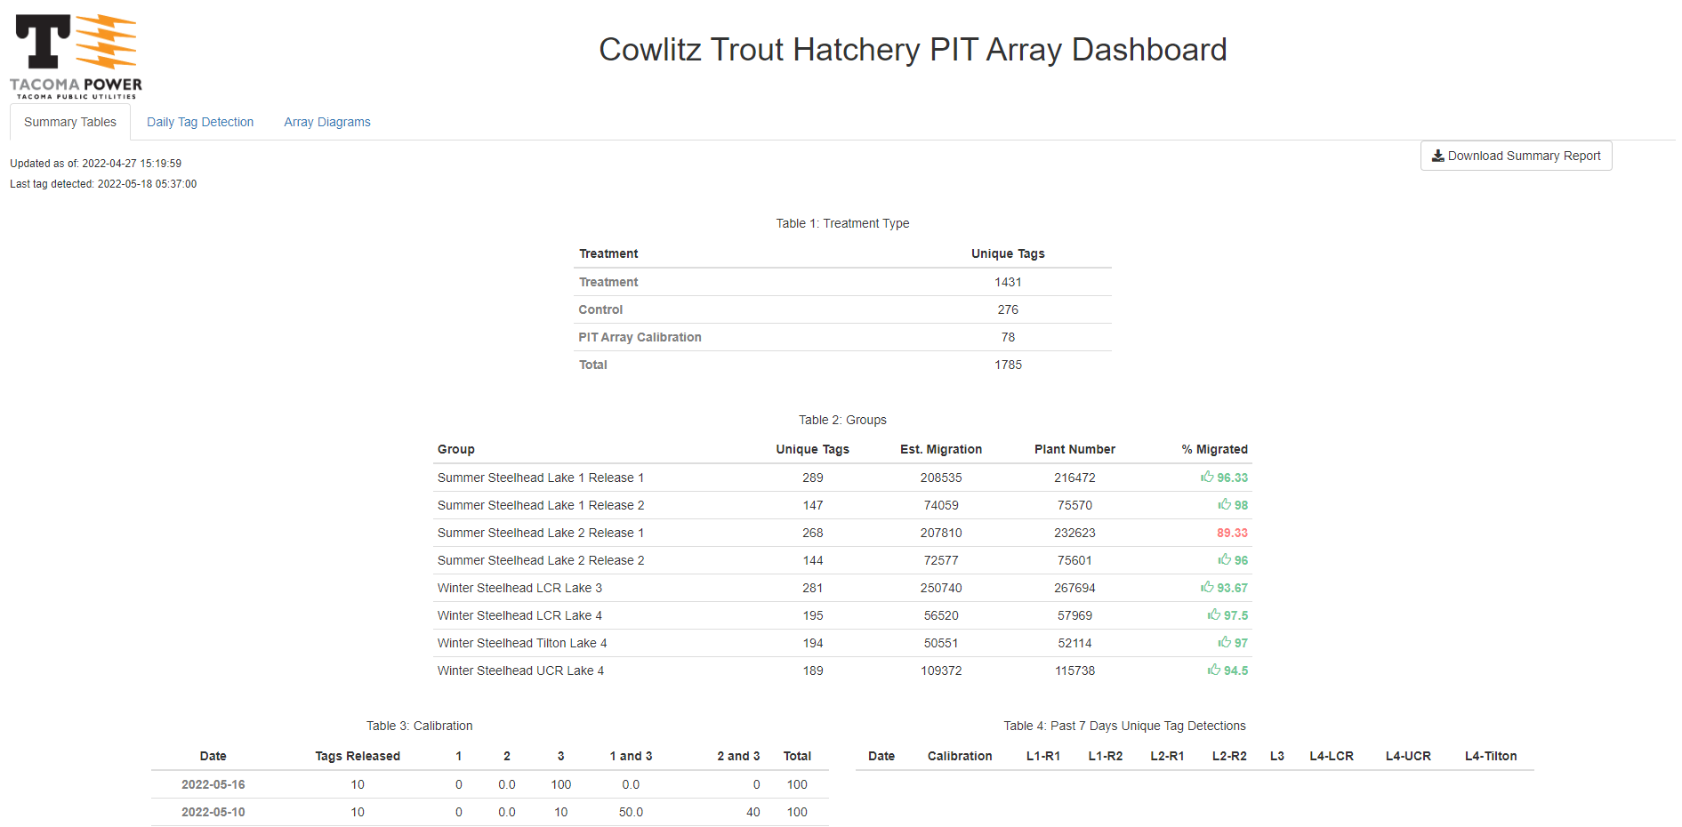
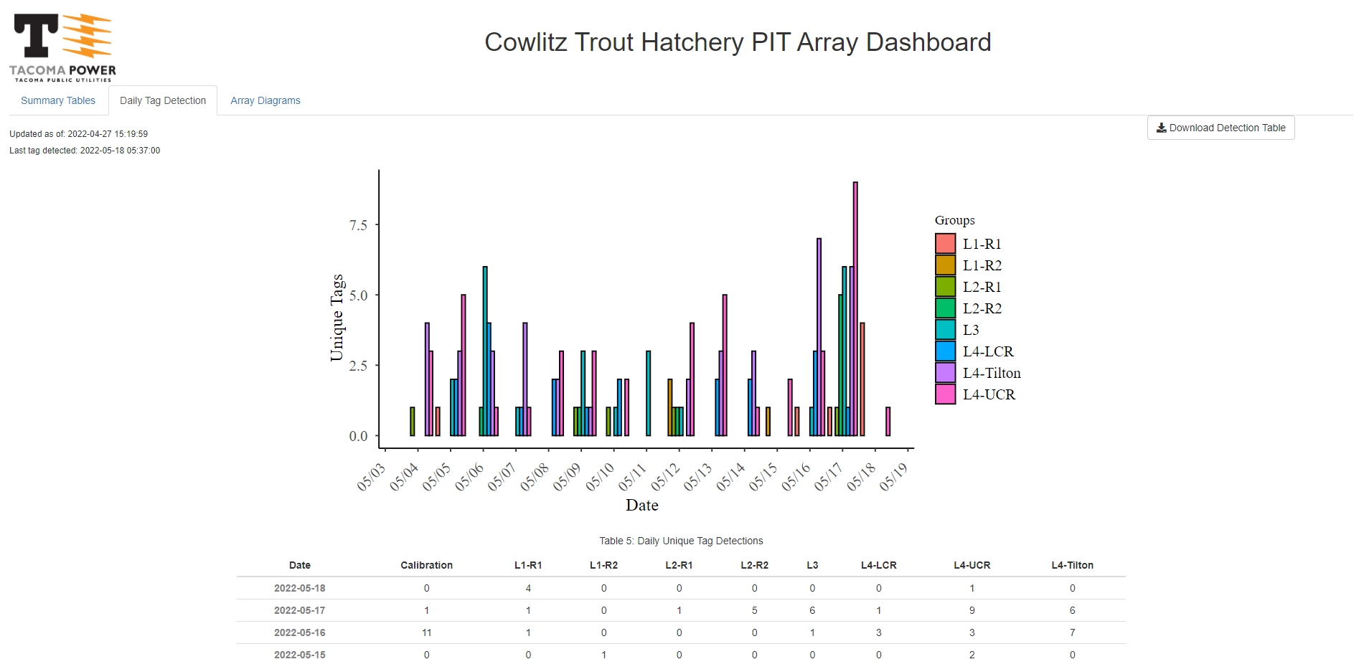
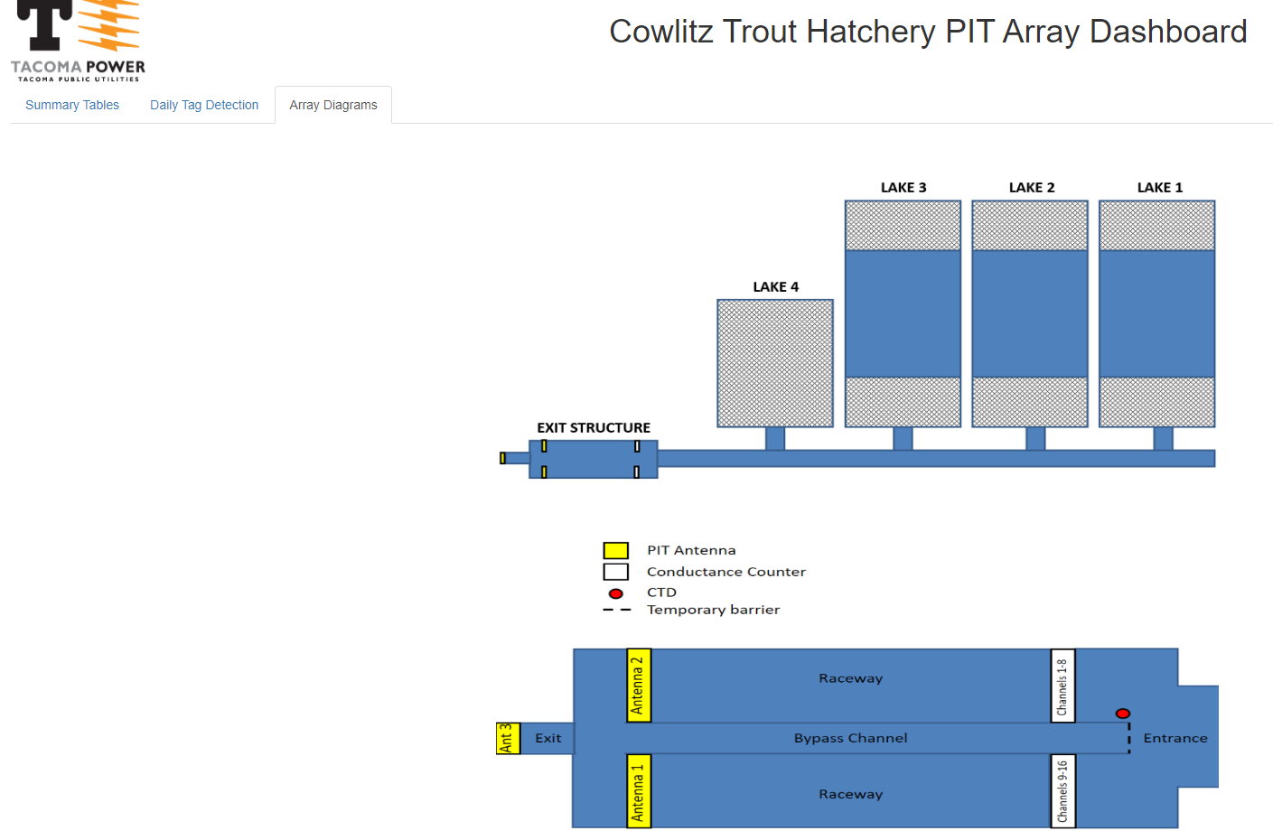
Cowlitz Trout Hatchery PIT Array Dashboard
Rshiny application
Static report production from within the application
Daily data pipeline constructed using Excel, FME, AWS, Snowflake and Shiny
Designed as a duplicate of the Tableau dashboard to allow for monitoring by contracted parties outside the City of Tacoma
https://tacoma.shinyapps.io/CTH_PIT_ARRAY/?_ga=2.202115601.10456577.1641499143-898210803.1635523745

Slide 5
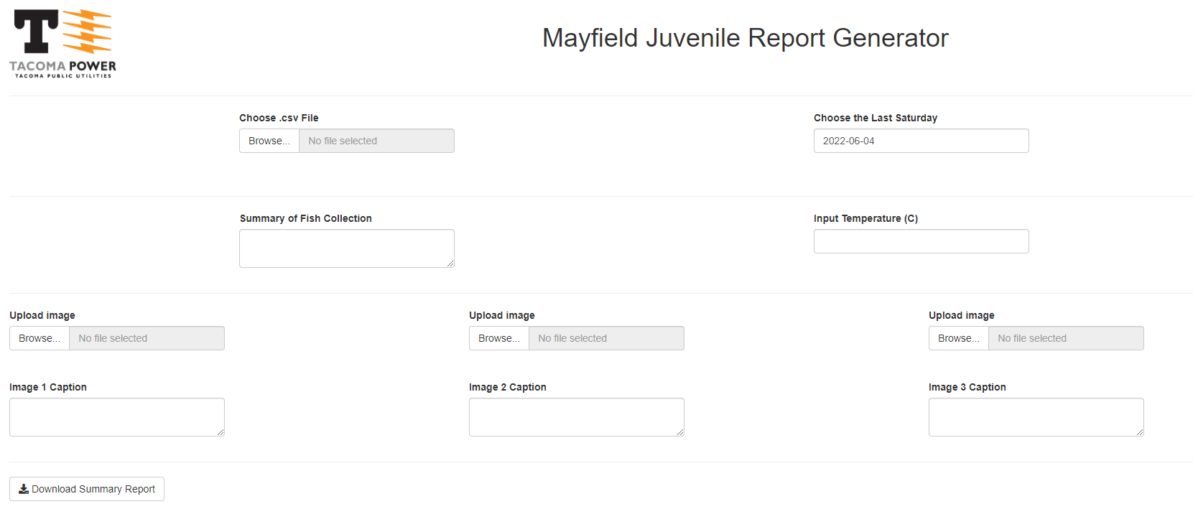
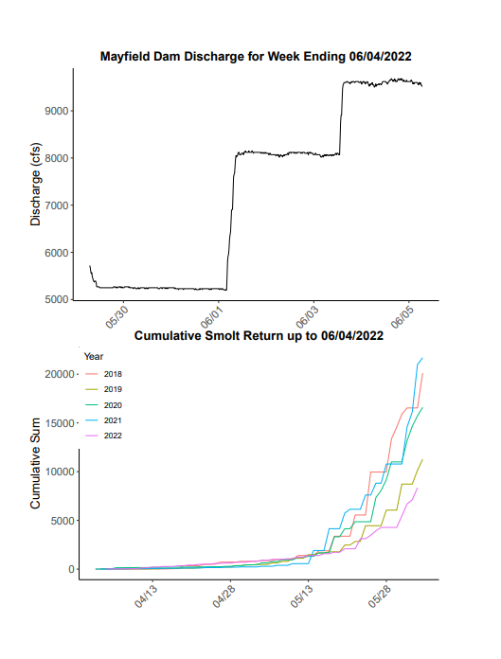
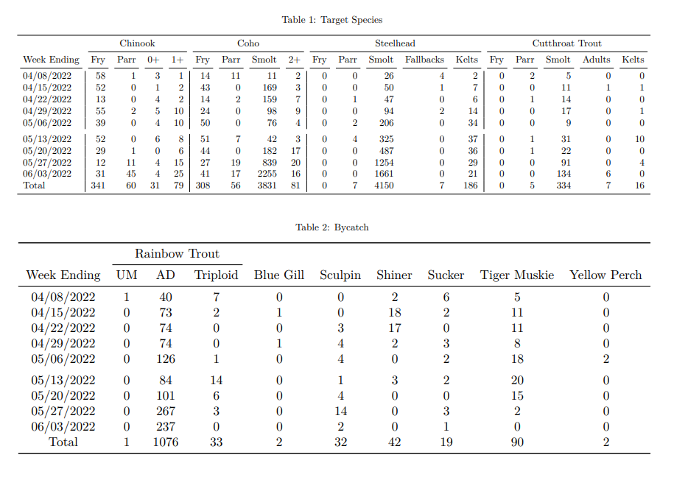
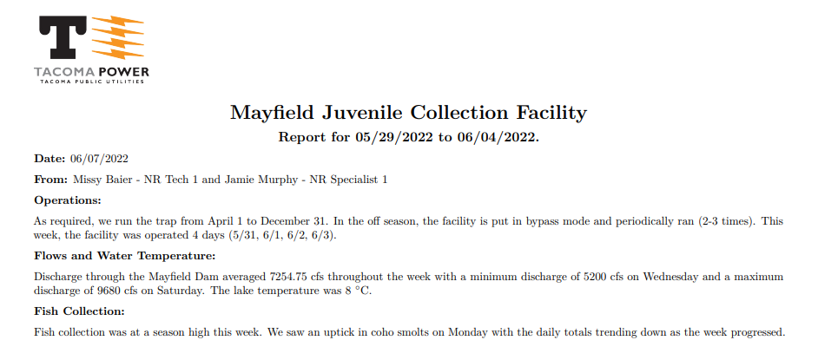
Mayfield Juvenile Report Generator
Rshiny form submitter
Designed to construct weekly project reports using user data inputs
Allows for custom reports that
Eliminates potential reporting errors
Saves staff 2-3 hours weekly
https://tacoma.shinyapps.io/cowlitz_mayfield_report_generator/

Slide 6
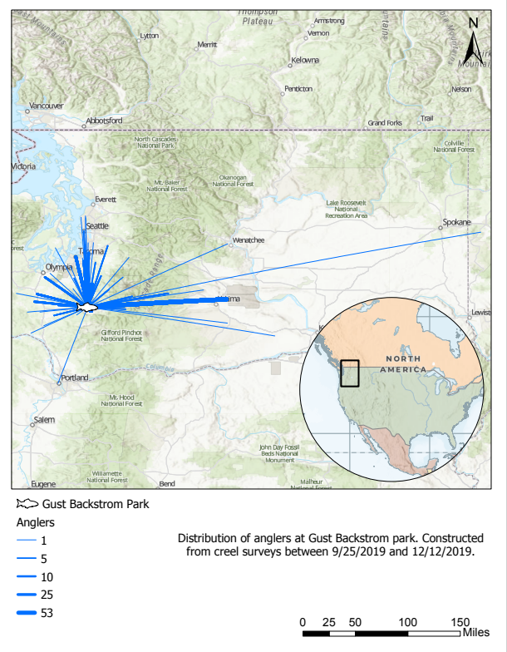
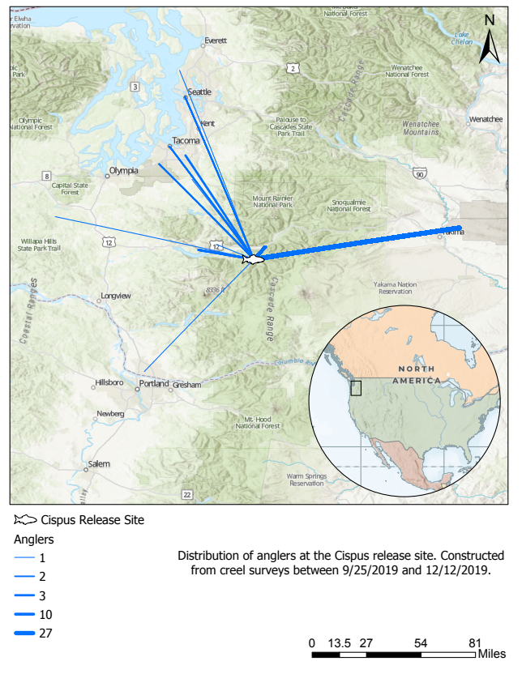
Creel Flow Map – ESRI ArcGIS Pro
ArcGIS Pro Flow Map
Depicts the density of anglers traveling to popular locations from their cities of residence
Created after extensive in person angler interviews

Slide 7
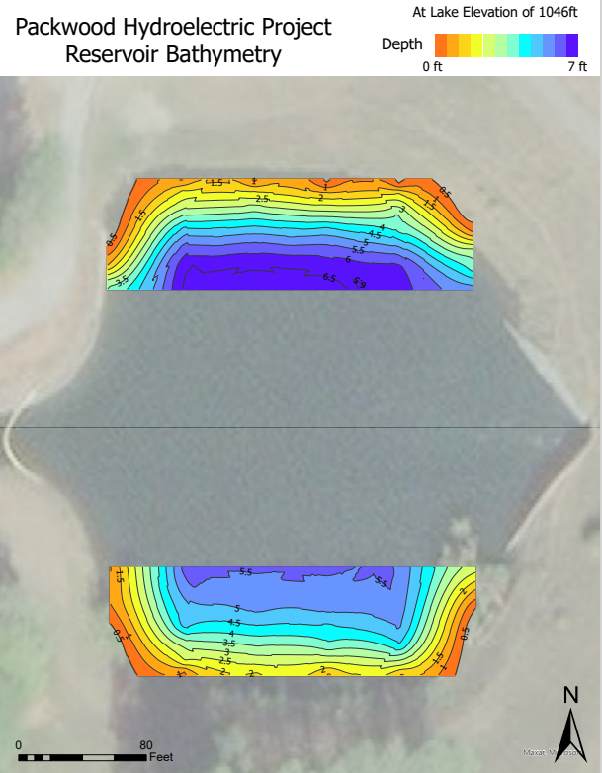
Bathymetry Map – ESRI ArcGIS Pro
ArcGIS Pro Bathymetry Map
Constructed from depth measurements collected in the field
Displays the bathymetry of the reservoir for the banks of concern
This project was a last minute project to meet an objective that we were not aware of. My team was not prepared for this project and we had to use equipment that was not optimal for the job. Even with these potential setbacks we were able to gather meaningful data. From that data, I constructed this figure which exceeded managements’ expectations.

Slide 8
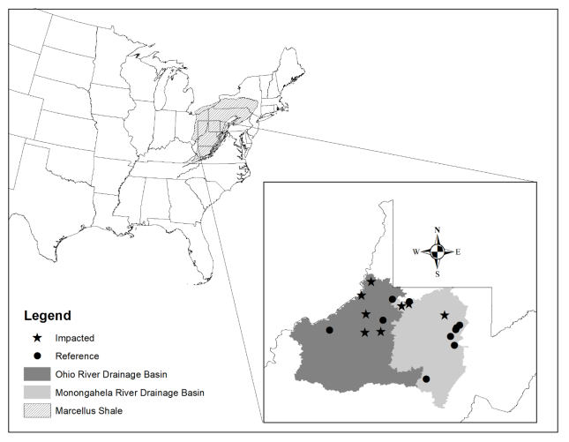
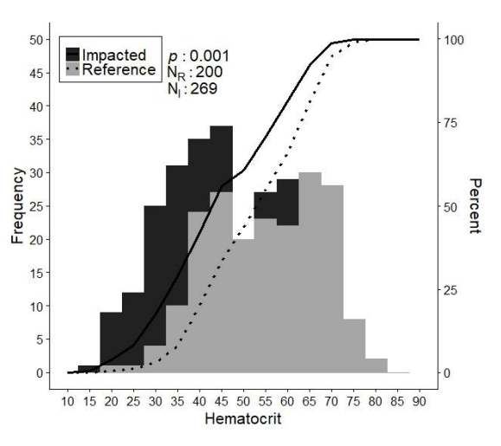
Data Visualizations - M.Sc. Thesis
ArcGIS Pro (right) and ggplot – R (below) visualizations from my Graduate Thesis
Extensive data collection, database management, data visualization and data analysis
https://researchrepository.wvu.edu/cgi/viewcontent.cgi?article=4946&context=etd

